Slide 1
Electronic Devices
Final Term Lecture - 05
Reference book:
Electronic Devices and Circuit Theory (Chapter-6)
Robert L. Boylestad and L. Nashelsky , (11th Edition)

Slide 2
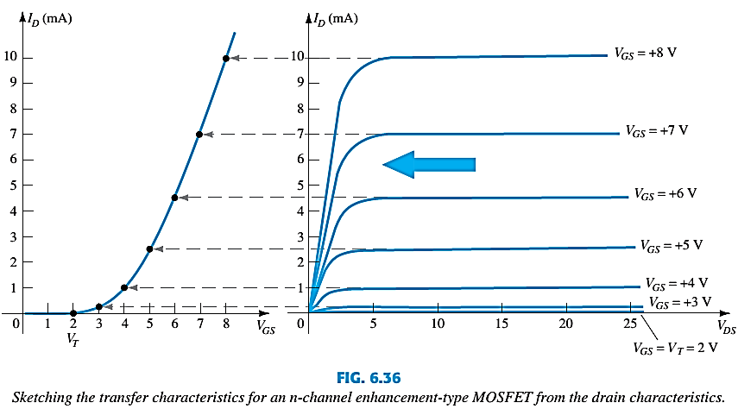
TRANSFER CURVE
To determine I_{D} given V_{GS}:
where V_{T} = threshold voltage or voltage at which the MOSFET turns on.
k = constant found in the specification sheet
k can also be determined by using values at a specific point and the formula:
V_{DSsat} can also be calculated:

Slide 3
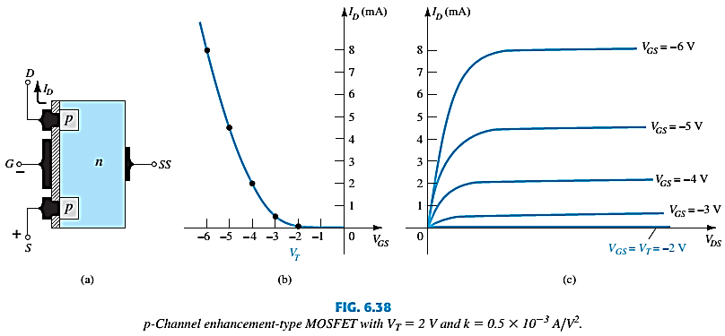
P -CHANNEL ENHANCEMENT-TYPE MOSFETS
The p-channel Enhancement-type MOSFET is similar to the n-channel except that the voltage polarities and current directions are reversed.

Slide 4
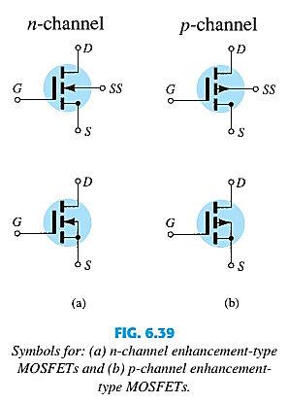
SYMBOLS

Slide 5
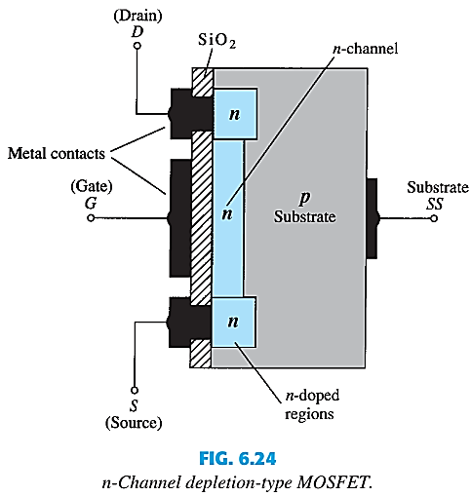
DEPLETION-TYPE MOSFET CONSTRUCTION
The Drain (D) and Source (S) connect to the to n-doped regions.
These N-doped regions are connected via an n-channel. This n-channel is connected to the Gate (G) via a thin insulating layer of SiO2.
The n-doped material lies on a p-doped substrate that may have an additional terminal connection called SS.

Slide 6
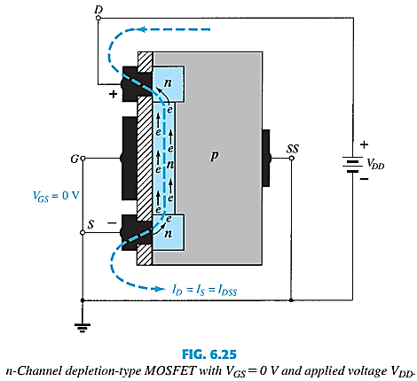
BASIC OPERATION
In Fig. 6.25 the gate-to-source voltage is set to 0 V by the direct connection from one terminal to the other, and a voltage V_{DD} is applied across the drain-to-source terminals.
The result is an attraction of the free electrons of the n-channel for the positive voltage at the drain.
The result is a current similar to that flowing in the channel of the JFET. In fact, the resulting current with V_{GS} = 0 V continues to be labeled I_{DSS.}

Slide 7
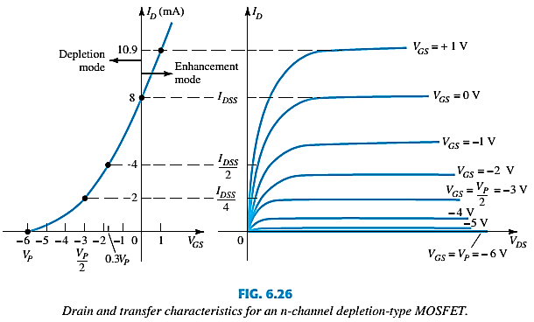
BASIC OPERATION
A Depletion MOSFET can operate in two modes: Depletion or Enhancement mode.

Slide 8
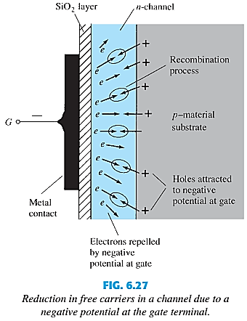
BASIC OPERATION CONTD.
In this figure V_{GS} has been set at a negative voltage such as 1 V. The negative potential at the gate will tend to pressure electrons toward the p-type substrate (like charges repel) and attract holes from the p-type substrate (opposite charges attract).
Depending on the magnitude of the negative bias established by V_{GS}, a level of recombination between electrons and holes will occur that will reduce the number of free electrons in the n-channel available for conduction. The more negative the bias, the higher the rate of recombination.
The resulting level of drain current is therefore reduced with increasing negative bias for V_{GS} for V_{GS} =1 V, 2 V, and so on, to the pinch-off level of 6 V. The resulting levels of drain current and the plotting of the transfer curve proceeds exactly as described for the JFET.

Slide 9
DEPLETION-TYPE MOSFET IN DEPLETION MODE
Depletion mode:
The characteristics are similar to the JFET.
When V_{GS} = 0V, I_{D} = I_{DSS}
When V_{GS} < 0V, I_{D} < I_{DSS}
The formula used to plot the Transfer Curve still applies:

Slide 10
ENHANCEMENT MODE
For positive values of V_{GS}, the positive gate will draw additional electrons (free carriers) from the p-type substrate due to the reverse leakage current and establish new carriers through the collisions resulting between accelerating particles.
As the gate-to-source voltage continues to increase in the positive direction, the drain current will increase at a rapid rate.
The application of a positive gate-to-source voltage has “enhanced” the level of free carriers in the channel compared to that encountered with V_{GS} =0 V. For this reason the region of positive gate voltages on the drain or transfer characteristics is often referred to as the enhancement region,
The region between cutoff and the saturation level of I_{DSS} referred to as the depletion region.

Slide 11
DEPLETION-TYPE MOSFET IN ENHANCEMENT MODE
Enhancement mode:
V_{GS} > 0V, I_{D} increases above I_{DSS.}
The formula used to plot the Transfer Curve still applies:
(note that V_{GS} is now a positive polarity)

Slide 12
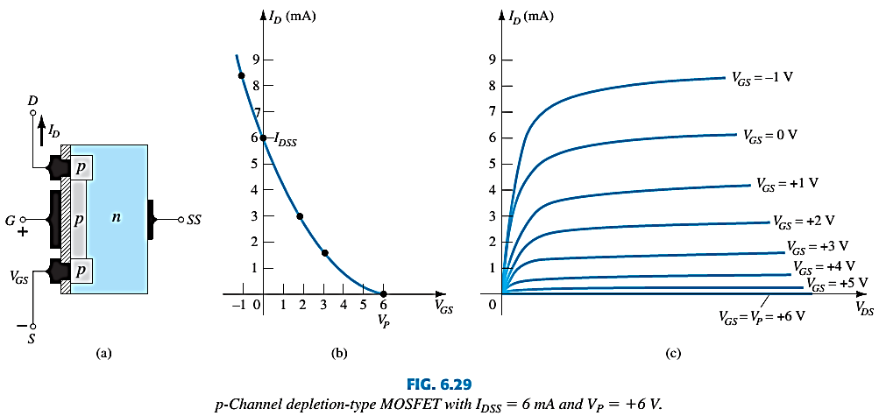
P-CHANNEL DEPLETION-TYPE MOSFET
The p-channel Depletion-type MOSFET is similar to the n-channel except that the voltage polarities and current directions are reversed.

Slide 13
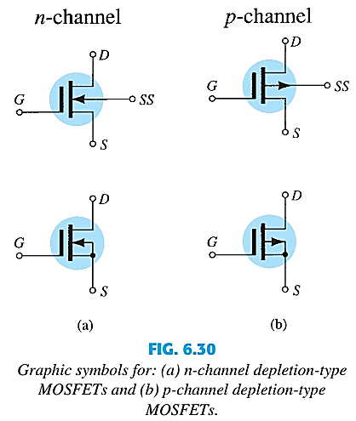
SYMBOLS

Slide 14
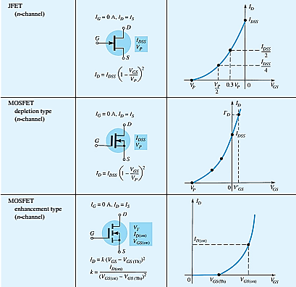
SUMMARY TABLE

Slide 15
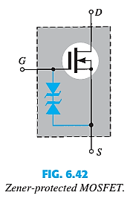
MOSFET HANDLING
MOSFETs are very static sensitive. Because of the very thin SiO2 layer between the external terminals and the layers of the device, any small electrical discharge can stablish an unwanted conduction.
Protection:
Always transport in a static sensitive bag.
Always wear a static strap when handling MOSFETS.
Apply voltage limiting devices between the Gate and Source, such as back-to-back Zeners to limit any transient voltage.

Slide 16
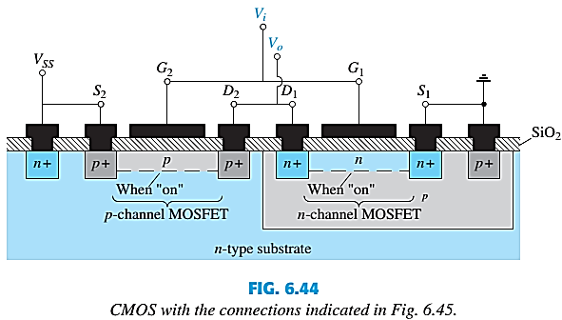
CMOS
CMOS – Complementary MOSFET p-channel and n-channel MOSFET on the same substrate.
Advantage:
Useful in logic circuit designs
Higher input impedance
Faster switching speeds
Lower operating power levels
Application:
CMOS Inverter

Slide 17
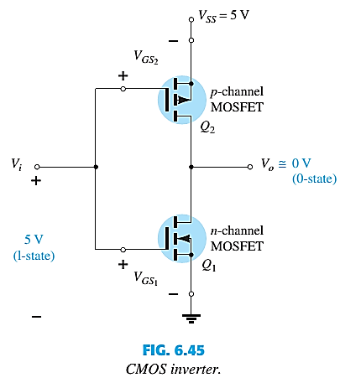
CMOS INVERTER
An inverter is a logic element that “inverts” the applied signal. That is, if the logic levels of operation are 0V (0-state) and 5V (1-state), an input level of 0V will result in an output level of 5V, and vice versa.
Here, both gates are connected to the applied signal and both drain to the output V_{o}. The source of the p-channel MOSFET (Q₂) is connected directly to the applied voltage V_{SS}, while the source of the n-channel MOSFET (Q₁) is connected to ground.
Here, the application of 5V at the input should result in approximately 0 V at the output. With 5V at V_{i} (with respect to ground), V_{GS1} = V_{i} and Q₁ is “on,” resulting in a relatively low resistance between drain and source.
Since V_{i} and V_{SS} are at 5 V, V_{GS2} = 0 V, which is less than the required V_{T} for the device, resulting in an “off” state. The resulting resistance level between drain and source is quite high for Q₂.

Slide 18
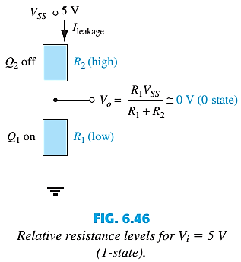
CMOS INVERTER
A simple application of the voltage-divider rule will reveal that V_{o} is very close to 0 V or the 0-state, establishing the desired inversion process.
For an applied voltage V_{i} of 0V (0-state), V_{GS1} = 0V and Q₁ will be off with V_{SS2} =-5V, turning on the p-channel MOSFET. The result is that Q₂ will present a small resistance level, Q₁ a high resistance, and V_{o} =V_{SS} =5 V (the 1-state).

Slide 19
End of Lecture-5

